Slide 1
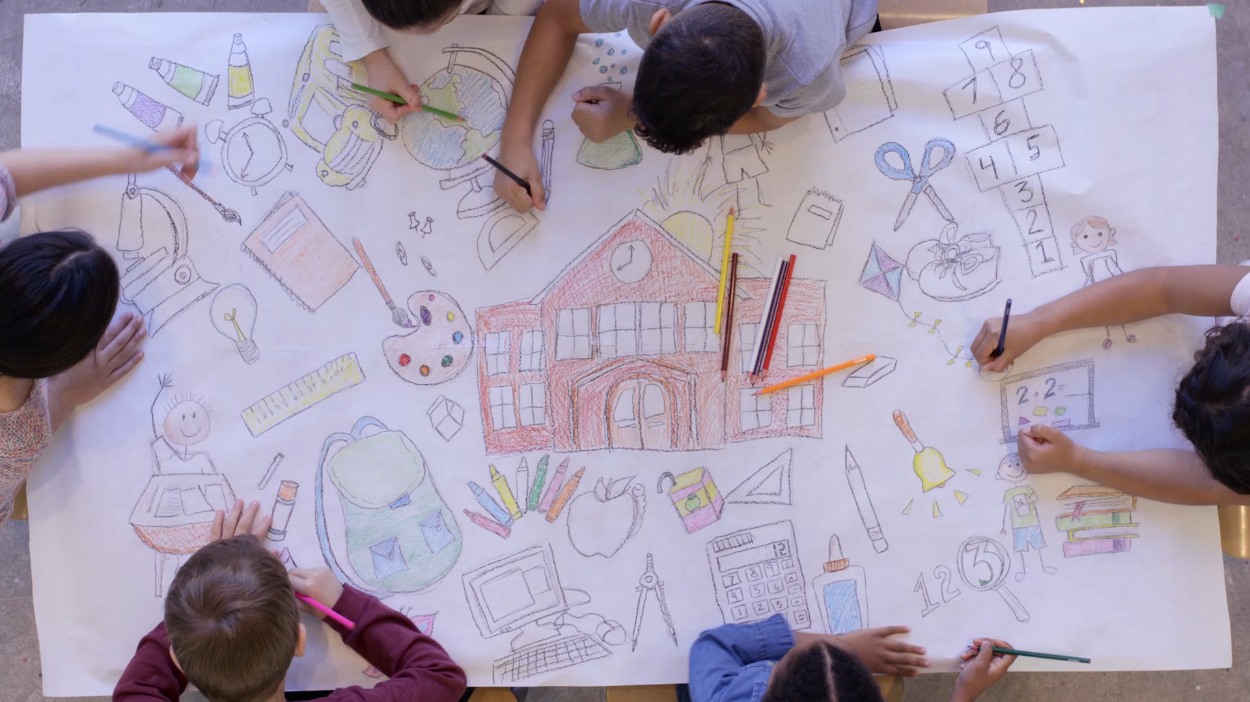
Making a difference in the world: Climate action in schools
Marta Jordán and Jesús María Mora.

Slide 2
Table of Contents
INTRODUCTION
OBJECTIVES
IMPLEMENTATION
CONCLUSION

Slide 3

Introduction
Do you think that climate change is caused by natural processes, human activity or both?
Notes:
Climate change is a broad topic that includes periodic alterations in Earth’s climate caused by natural processes in combination with the effects of various human activities.

Slide 4

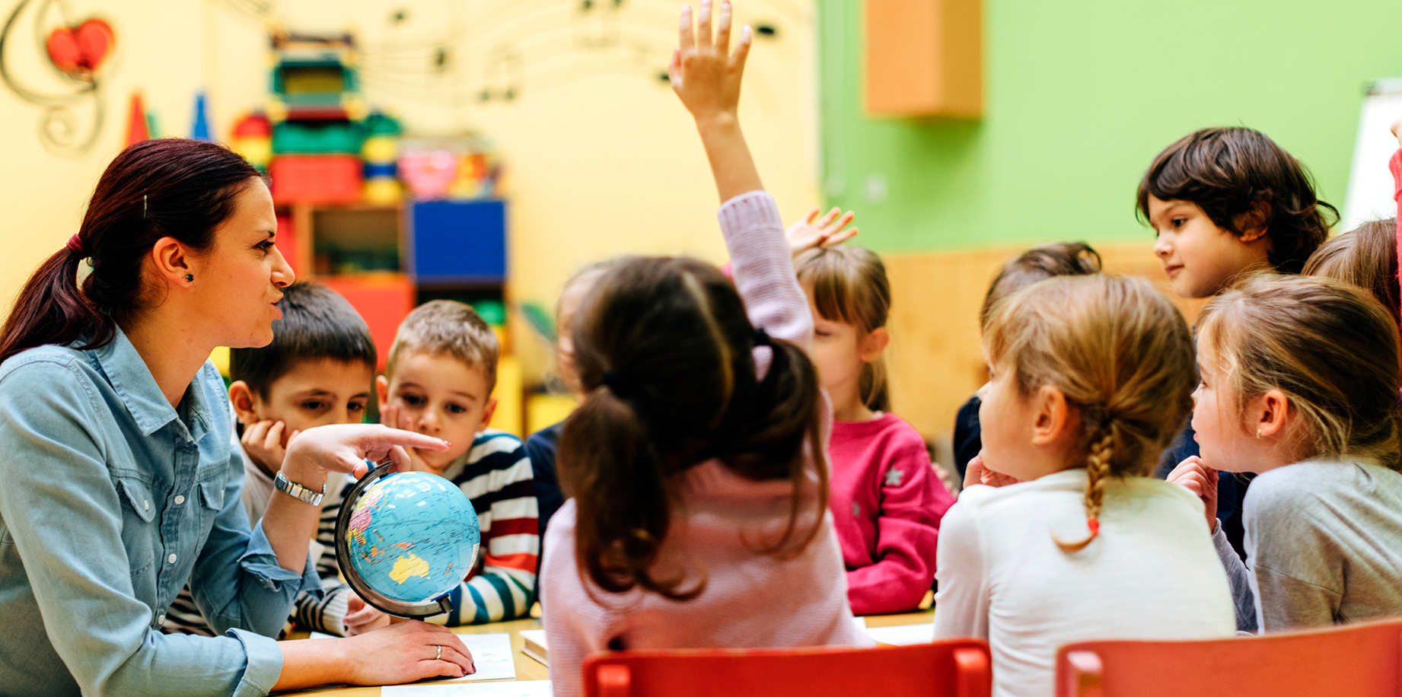
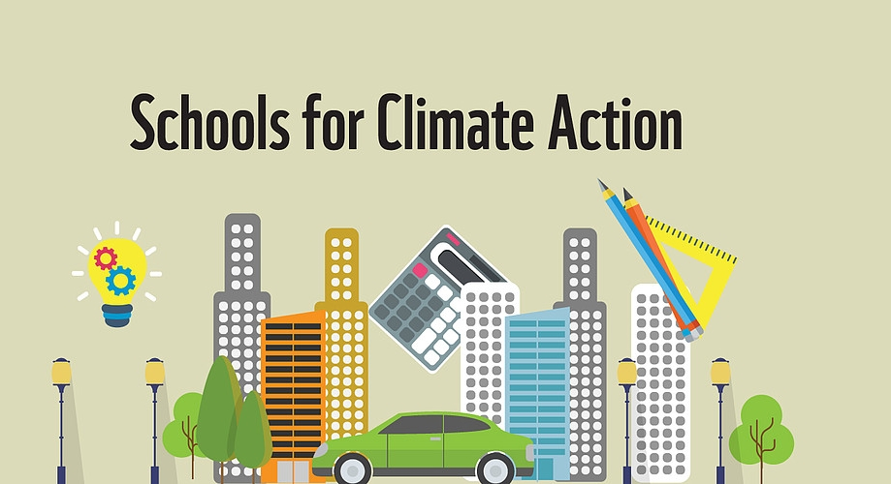
Objectives
The students, once the activity is over, are familiar with contamination, what its causes and what they have as consequence.
The students are able to propose solutions adapted to this problem.

Slide 5

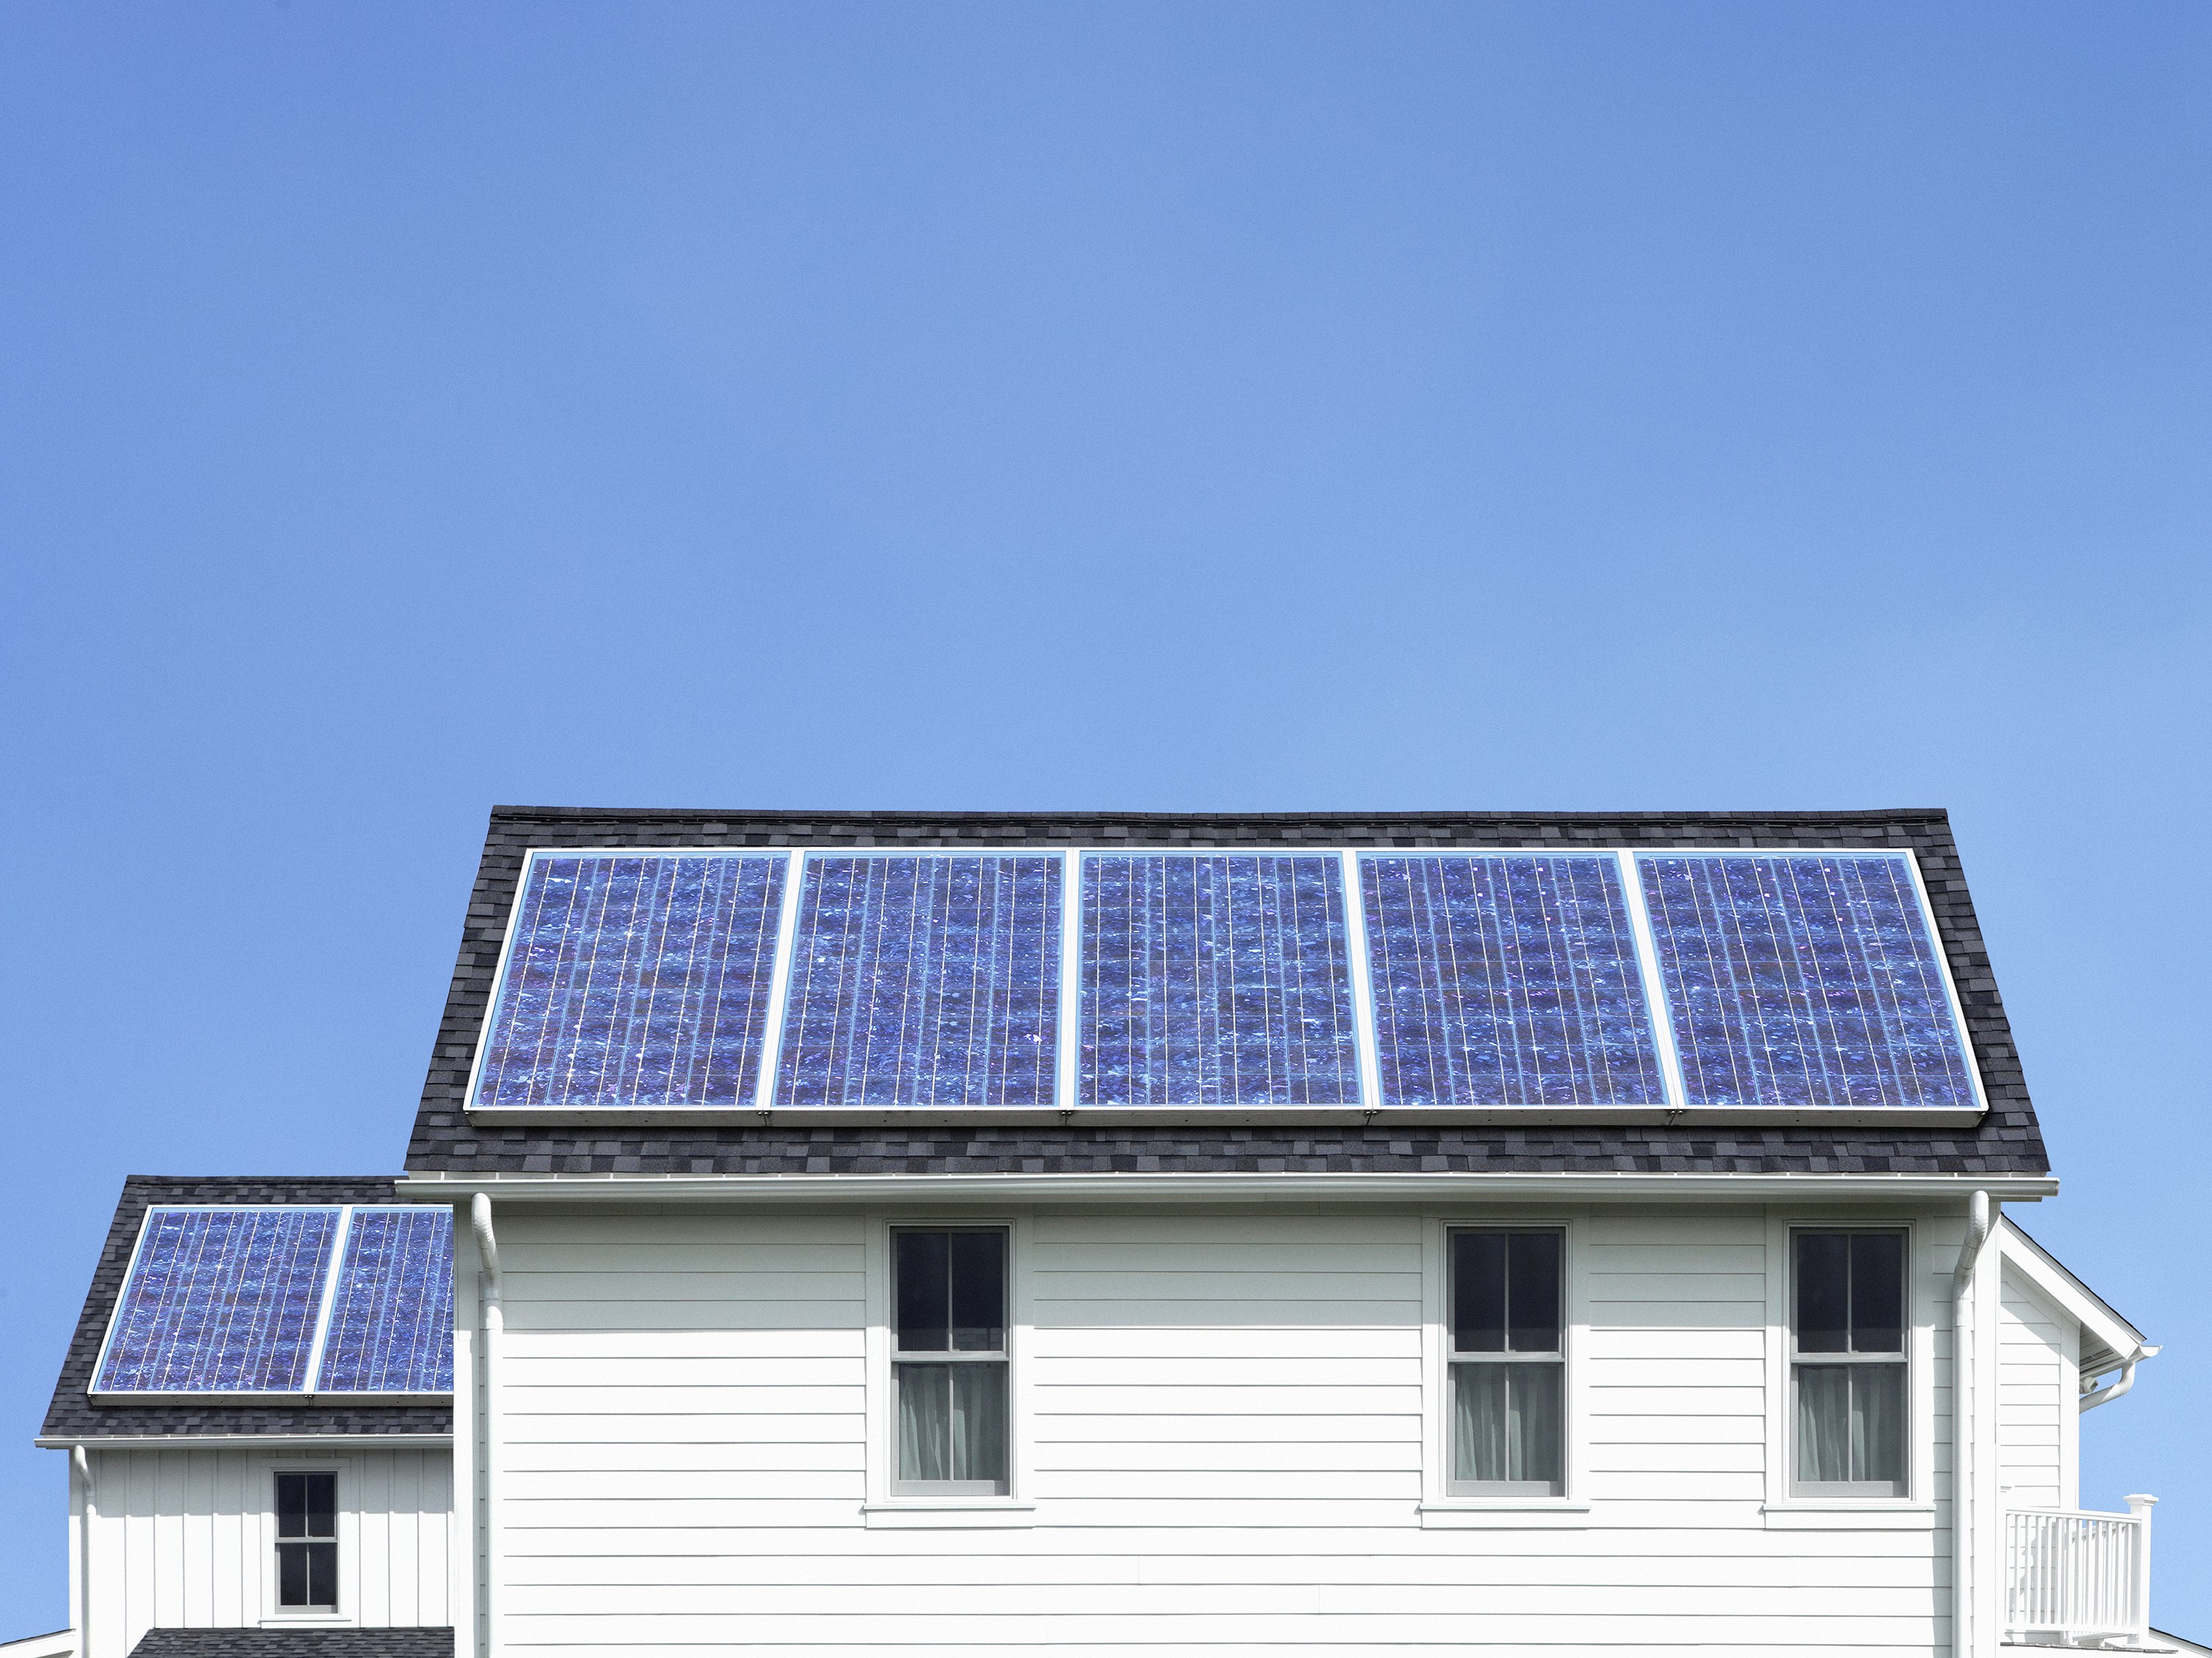

Implementation
State School.
Proyect-based learning.
Aim: Reduce carbon dioxide emissions in the school.
Preparing a renewable energy source for the class and the school.
Help of teachers and families will improve workflow.
Cross-discipline approach.
Adapting green skills to the school

Slide 6
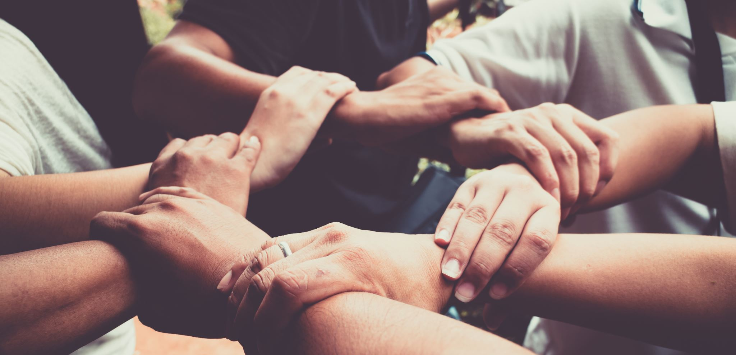
Conclusion
Good way to inplement an innovative purpose.
Cross-discipline.
Useful and representative learning.
Students will be aware of climate change, and they will know how to cope with it.
It's good for the students and for the school. Better income distribution

Slide 7
Making a difference in the world: Climate action in schools
Marta Jordán and Jesús María Mora.

